Slide 1
Maryland’s Hispanic Population and those Eligible to Vote

Slide 2
Growth in Maryland’s Hispanic Population
Hispanics had both the largest numeric gain and the largest percentage increase in population in Maryland over the 2000 to 2014 period. During this 14-year period, the Hispanic population grew by just over 329,000, or almost 145 percent.

Slide 3
Maryland’s Population Change by Non-Hispanic Race and Hispanic Origin, April 1, 2000 to July 1, 2014
Source: U.S. Census Bureau, 2000 Census and 2014 population estimates

Slide 4
Maryland’s Percent Population Change by Non-Hispanic Race and Hispanic Origin, April 1, 2000 to July 1, 2014
Source: U.S. Census Bureau, 2000 Census and 2014 population estimates

Slide 5
Growth in Maryland’s Hispanic Population
But because the growth of Hispanics in Maryland is a recent phenomenon, the Hispanic share of the overall population averaged only 8.8 percent over the 2010-2014 period, although for two jurisdictions, Montgomery (17.9%) and Prince George’s (15.9%) counties, it’s much higher.*
* The data in this slide and in the rest of the analysis, data is based on 2010-2014 five-year tabulations from the American Community Survey CVAP tabulations

Slide 6
Hispanics as a Percent of the Population for Maryland’s Jurisdictions (2010-2014)
Source: U.S. Census Bureau, 2010-2014 American Community Survey CVAP tabulation

Slide 7
Maryland’s Voting-Eligible Hispanic Population
While Hispanics are a growing share of the State’s population, they are not yet proportionately represented in the voting-eligible population because they tend to 1) have a higher proportion of their population under age 18, and 2) a majority of Hispanics statewide over the age of 18 are not citizens.

Slide 8
Percent of each Race/Hispanic group that is less than 18 Years of Age for Maryland, 2010-2014
Source: U.S. Census Bureau, 2010-2014 American Community Survey CVAP tabulation

Slide 9
Percent of Hispanics Ages 18+ who are Citizens by Maryland Jurisdiction (2010-2014)
Source: U.S. Census Bureau, 2010-2014 American Community Survey CVAP tabulation

Slide 10
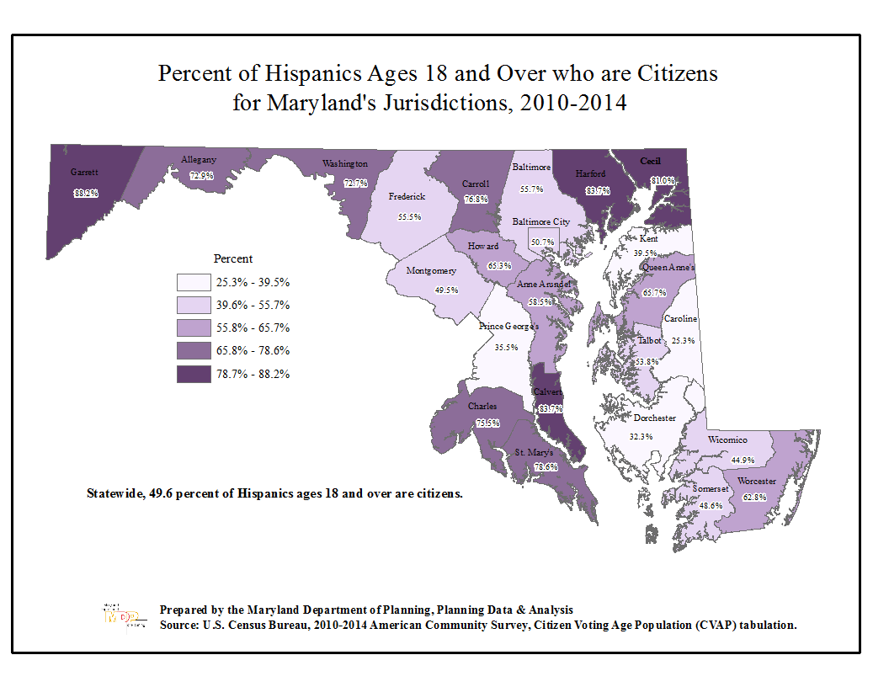

Slide 11
Maryland’s Voting Eligible Hispanic Population
Therefore, while Hispanics make up just under 9 percent of Maryland’s overall population, they make up just under 8 percent of those 18 and over, and just over 4 percent of those who are age 18 and over and who are citizens.
For Montgomery County, where Hispanics make up more than one out of six of the total population, those eligible to vote are one out of 10. For Prince George’s County, Hispanics are 15.9 percent of the total population but only 5.9 percent of the voting eligible population.

Slide 12
Hispanics Ages 18 and Over as a Percent of the Total Population Ages 18 and Over (2010-2014)
Source: U.S. Census Bureau, 2010-2014 American Community Survey CVAP tabulation

Slide 13
Hispanics Eligible to Vote as a Percent of All Eligible Voters by Maryland Jurisdiction, (2010-2014)
Source: U.S. Census Bureau, 2010-2014 American Community Survey CVAP tabulation

Slide 14
Maryland’s Voting-Eligible Hispanic Population
In the next couple of decades, however, Hispanics will become a greater force in the electorate, as those under age 18 become 18 and over, and since the vast majority of those now under age 18 are already citizens (89.7%).

Slide 15
Percent of Hispanics Under Age 18 who are Citizens, by Maryland Jurisdiction, 2010-2014
Source: U.S. Census Bureau, 2010-2014 American Community Survey CVAP tabulation

Slide 16
Citizen Voting Age Population (CVAP) Special Tabulation
From the 2010-2014 5-Year American Community Survey ACS)
This is a special tabulation providing data on the citizen voting age population and other data from the 2010-2014 5-year American Community Survey (ACS). The ACS is the replacement for the decennial census long form. This is the sixth release of this special tabulation of ACS data. Previous releases used data from the 2005-2009, 2006-2010, 2007-2011, 2008-2012 and 2009-2013 5-year ACS. Data from all five releases are available on the Census Bureau’s Redistricting Office web site:
http://www.census.gov/rdo/data/voting_age_population_by_citizenship_and_race_cvap.html

